Slide 1
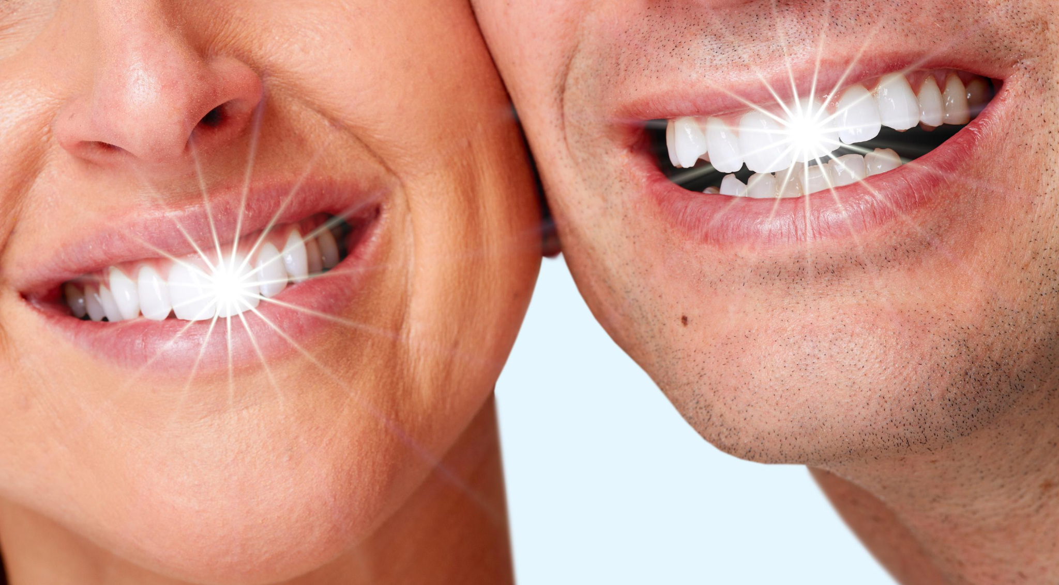

Say goodbye to plaque and caries!
Presented By Team Nanoshine (1.1.A)
Alex Weber Pranav Kulkarni Mandi Wang
Pranav Karthikeyan Mihir Kavishwar
Notes:
Intro and summary slide,
Summary slide with 4 to 5 points, describe the product aspects

Slide 2
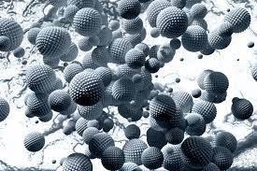
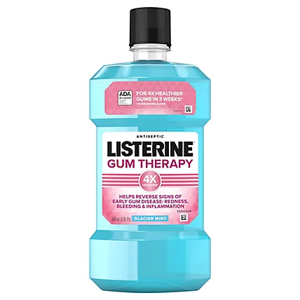
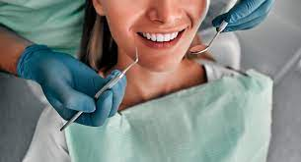
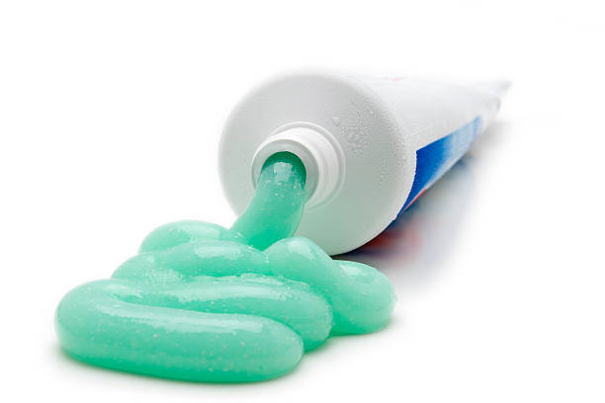
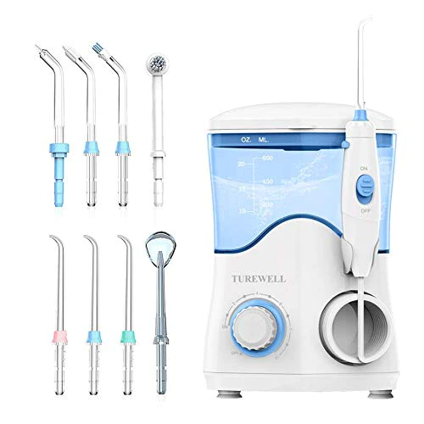
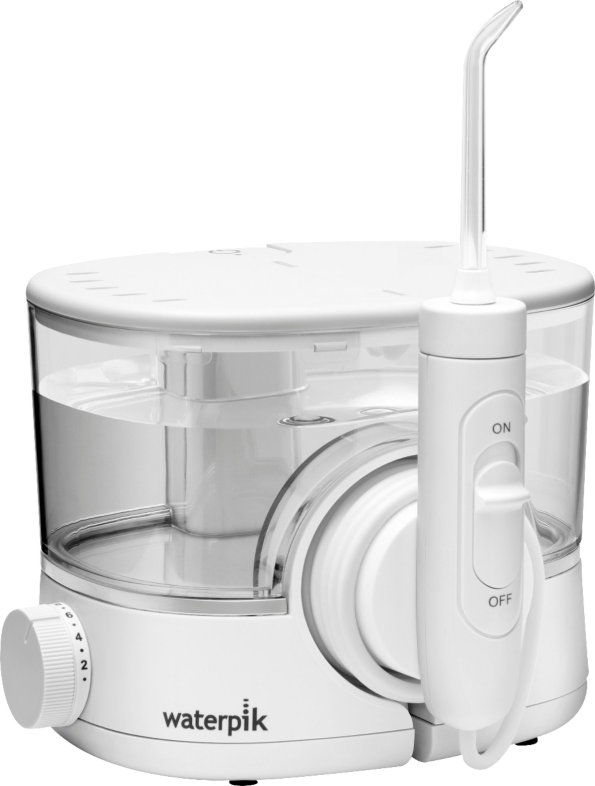
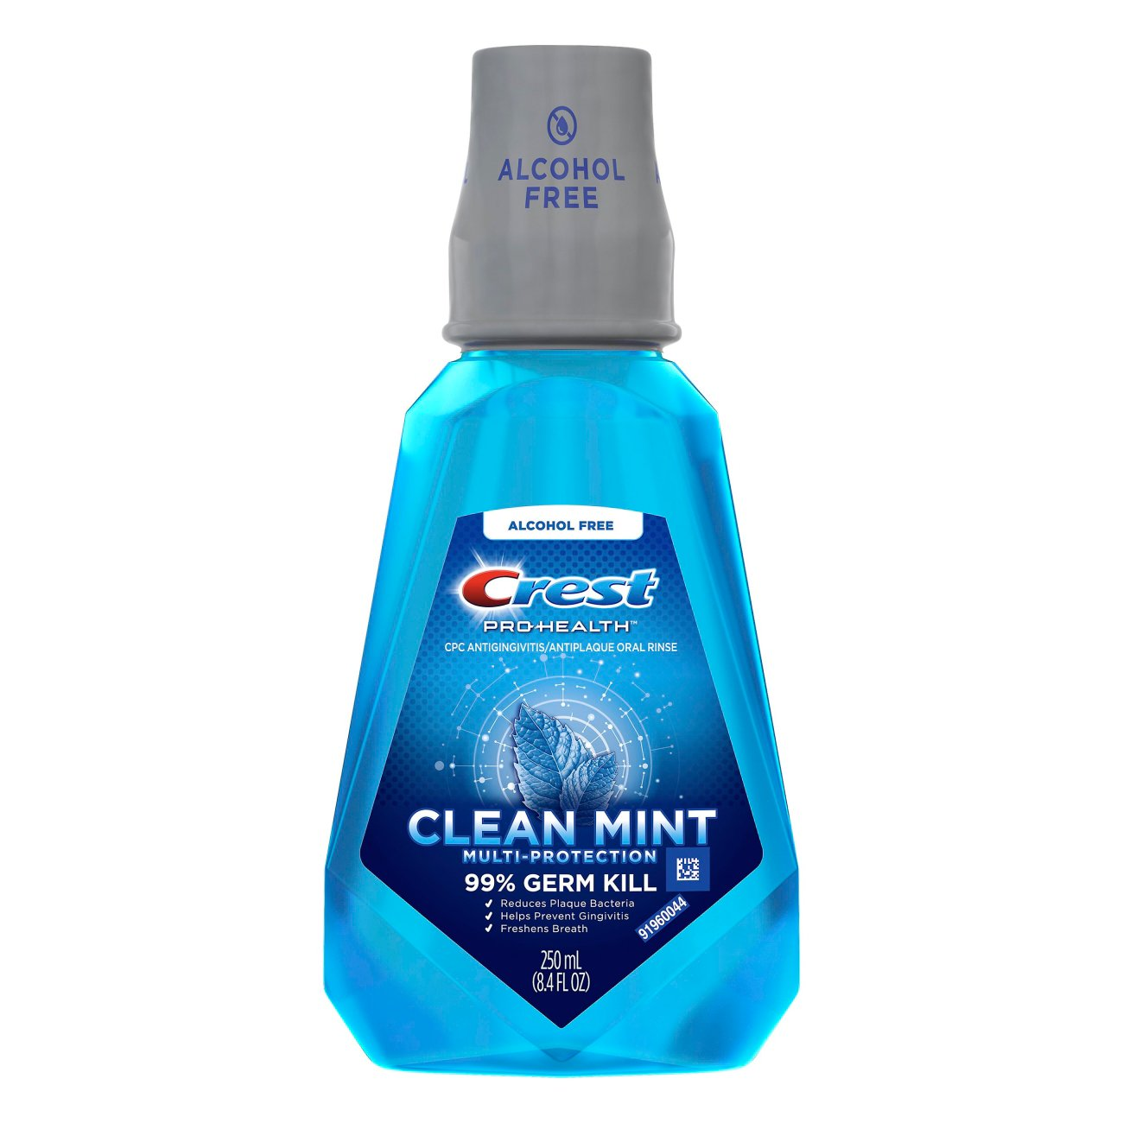
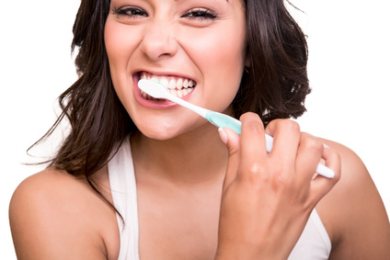
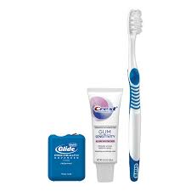
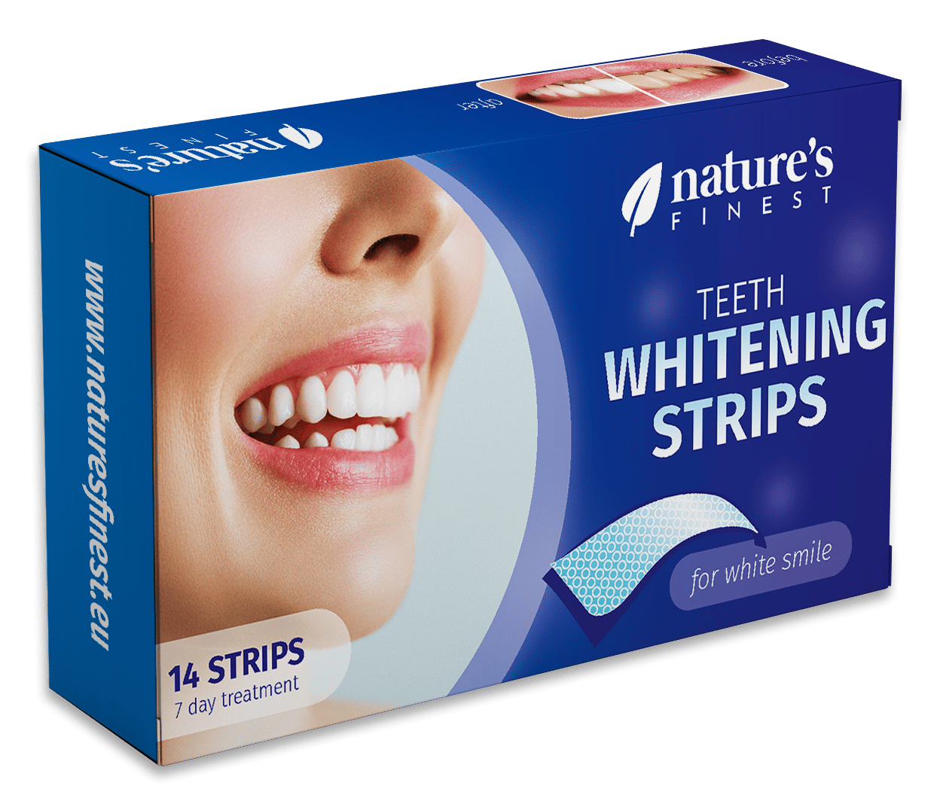
Commercial Application Area
Dental plaque is a biofilm that consists of a wide variety of microorganisms and their by-products.
  Once calcified, their removal is difficult, even with the use of professional dental instruments.
Nanoparticles must be routinely introduced to a biofilm in order to penetrate and disrupt its structural integrity
Our application will deliver the existing nanoparticle technology (developed by AMI) to treat dental biofilms in a way that places no additional burden on the patient.
Current Treatment Options
Applications Considered
Recommended Application
Notes:
Thanks Alex! Just a quick refresher on what’s the prob we’re dealing - biofilm. How we aim to fight it - nanotechnology. How does it work? And discuss 3 application areas briefly and what we recommend. Pranav Kulkarni

Slide 3
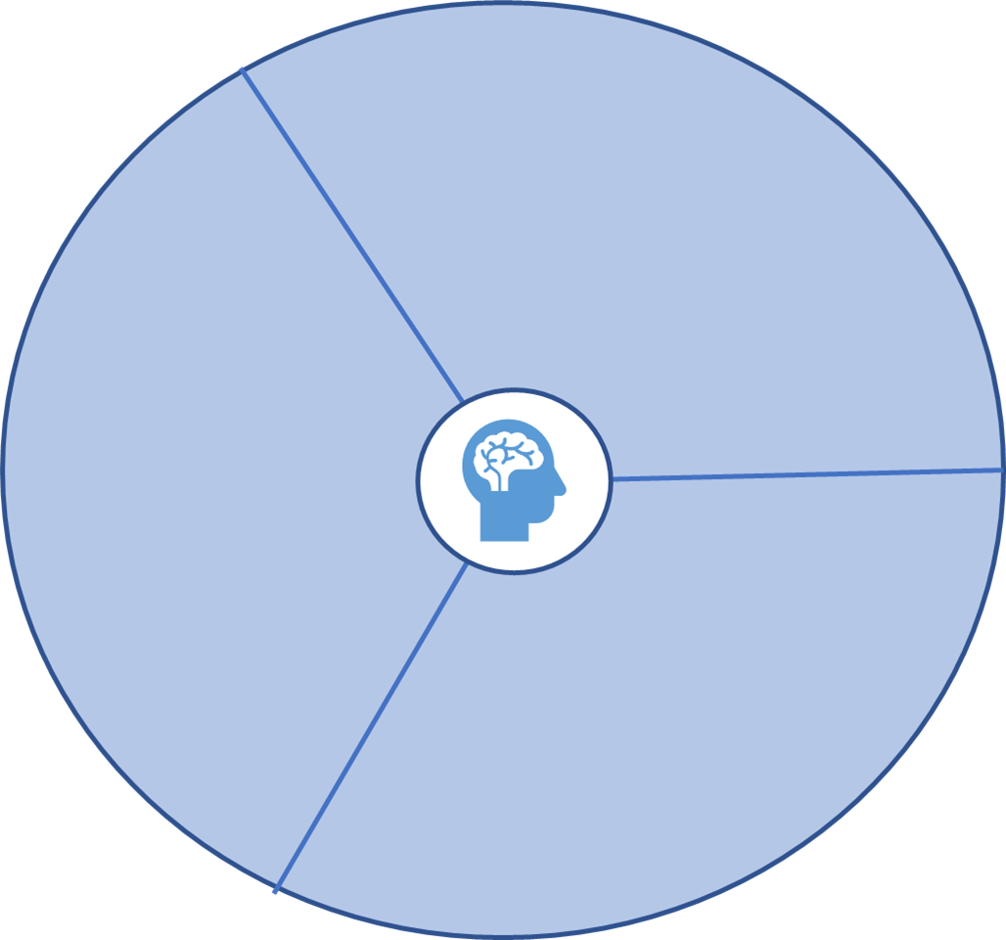
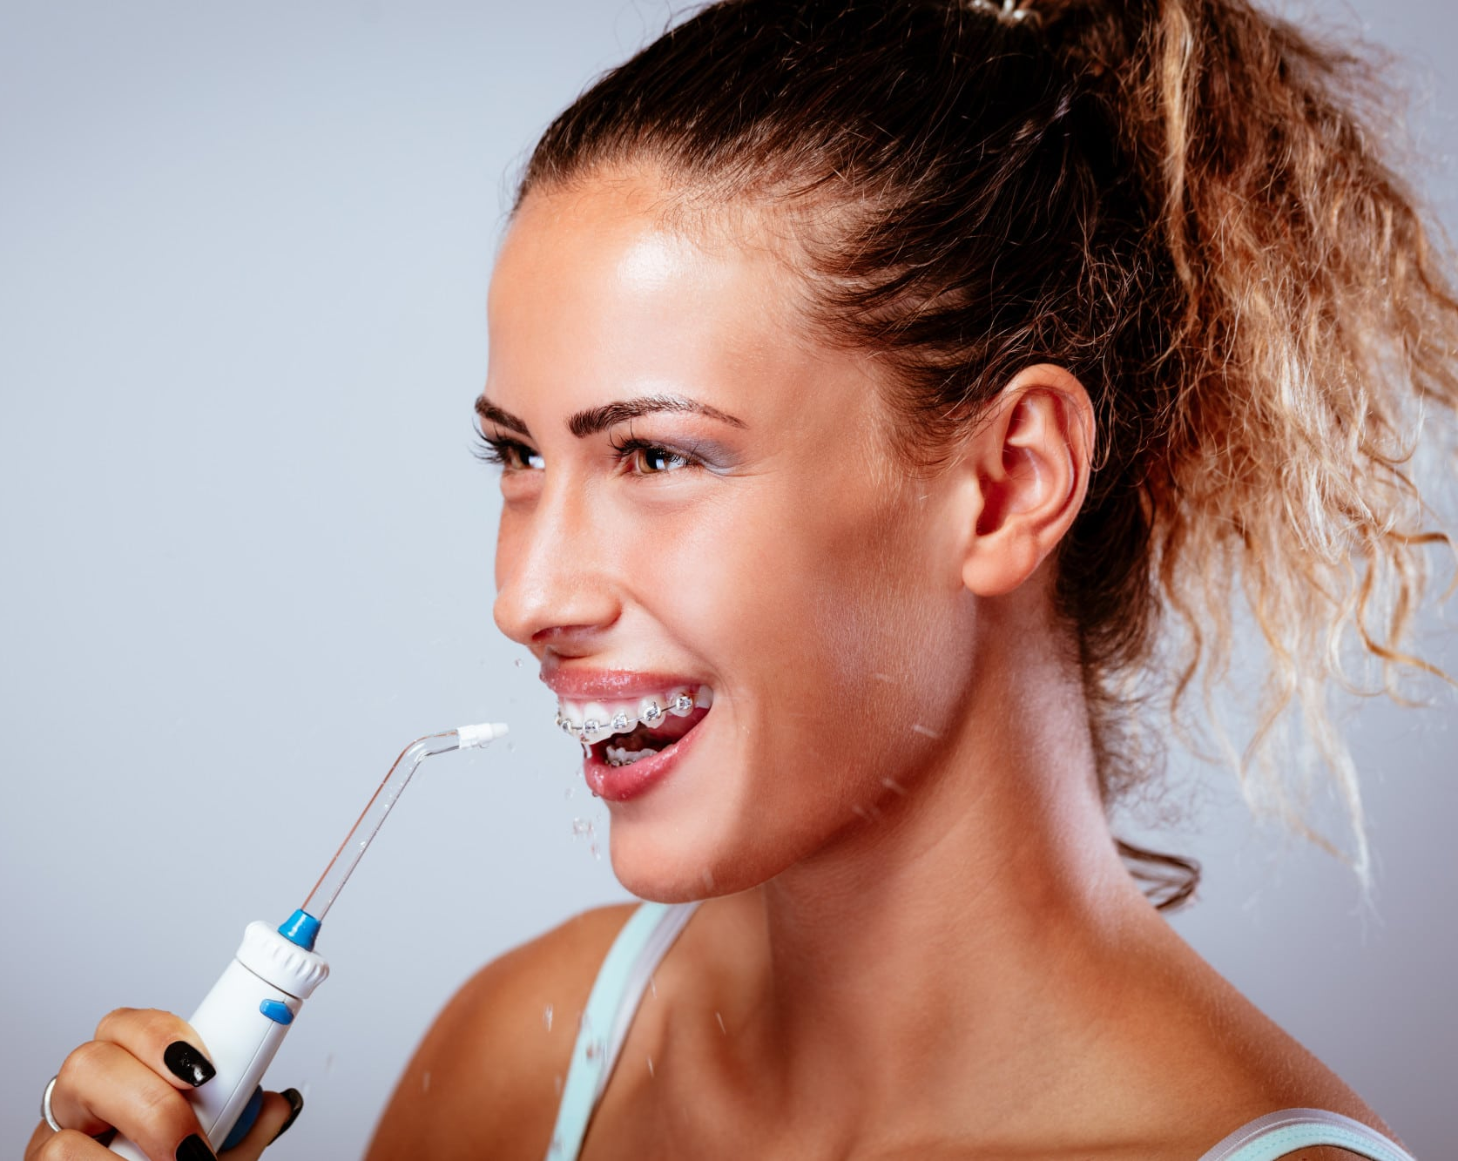



Main Customer Segment
WANTS
-Additional hygiene benefits without additional hassle
-Results that can be seen
The
“Extra Oral Hygiene Advocate”
WATER FLOSSER USER
NEEDS
-Proof that oral hygiene solutions actually work
-Recommendation /approval from a dental professional
FEARS
-Fears aging/ tooth decay
-Follows habits taught by family of origin, OR
All genders and races
Ages 25-60
-Avoids poor hygiene habits learned in family of origin
-Fear over facts
Demographic
Highly educated (undergraduate and beyond)
High disposable income
Access to quality dental care
Socioeconomic
Geographic
North America (this region holds majority market share in the water flosser market)
Notes:
Thank you Mihir,
Nanoparticles have wonderful application and they are great. But let's see, whos gonna use them.
We realised, people working in industry, probably after their late 20’s take the oral hygiene more seriously.
This customer segment is educated, they have money to spend.
Lets have a look at the mental model, of our main customer makes decision based on 3 things
- this segment need a proof that this product works or a recommendation from a doctor or hygienist
- They want to see visible result, without hassles like any surgeries. So they can spend more time than average but not as high as movie star.
- and fear is a big motivation for them. Fear of tooth decay or aging.
To summarize: Current water flosser users could be a great match for our main customer segment.
Let me pass the deck to Mani to discuss about patient journey

Slide 4
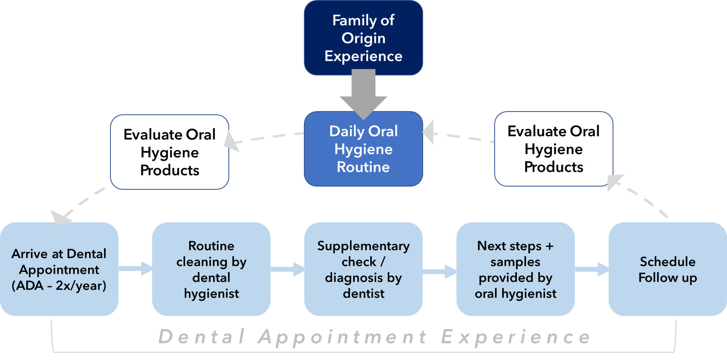
Patient Journey
Point of Intervention (though dental hygienist)

Slide 5
Interview Findings
1
2
3
4
5
Dentists
42 data points
Asking dentists.
In-person friends
Interviews
In-person interviews of our friends, family, and professors.
In-person random
Asking people in the JFF hallway including students and guards.
Dentists, hygienists, and family of origin educate on dental health
Patients are interested in improving their health & minimizing shame
Patients need proof that solutions actually work before commiting
Patients prioritize appearance of teeth over health of teeth
Patients think that they already have effective oral hygiene

Slide 6
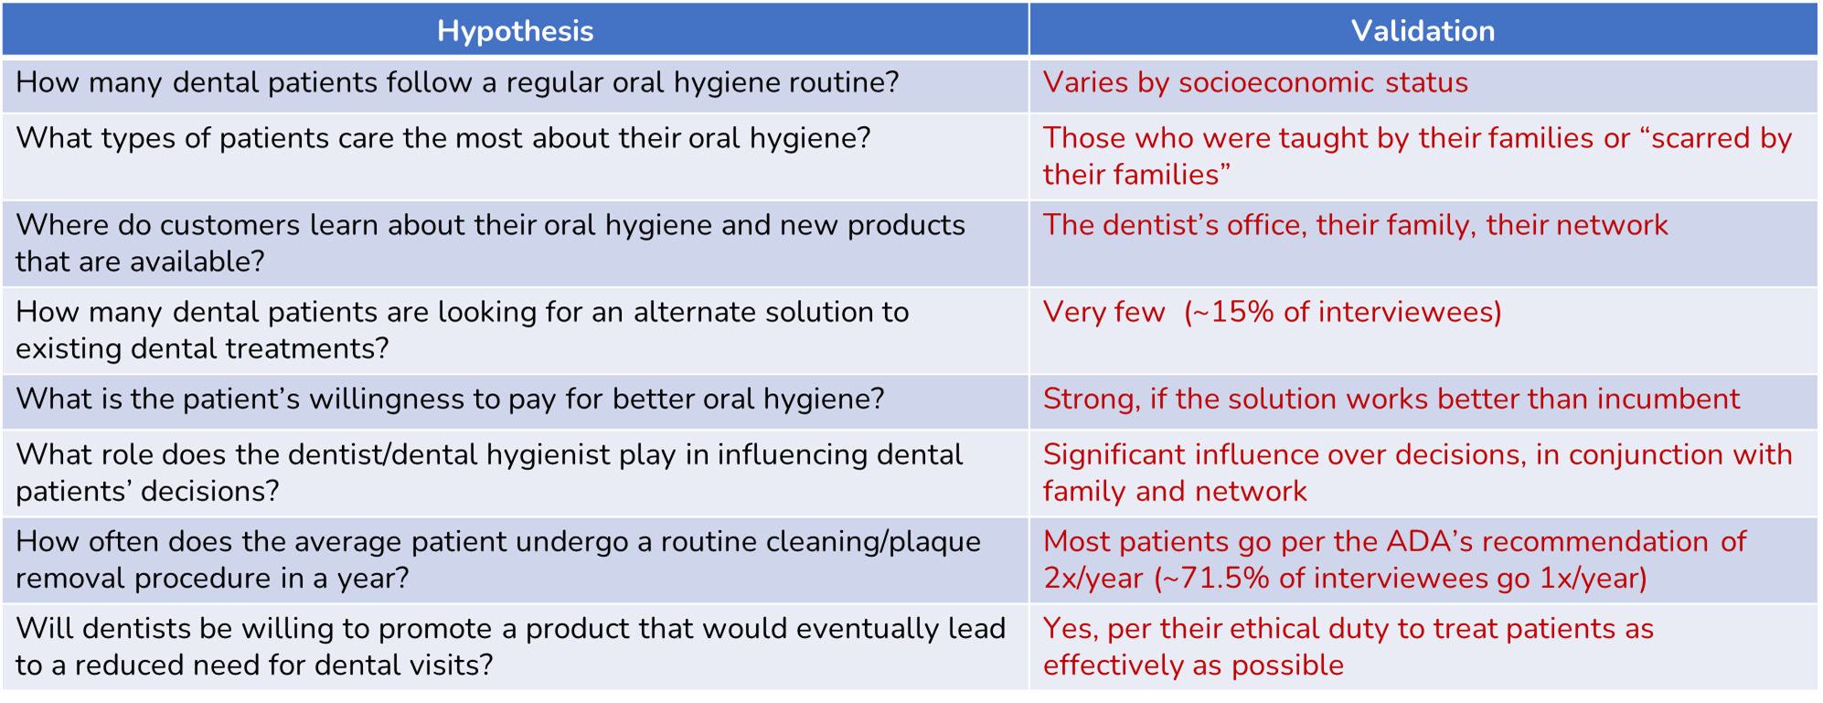
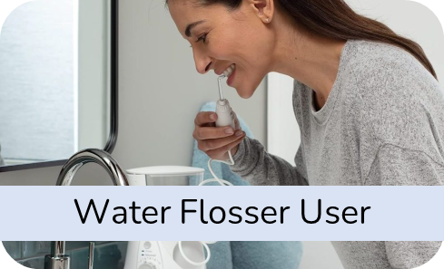


Hypothesis Testing & Market Entry
PRIMARY:
SECONDARY:

Slide 7
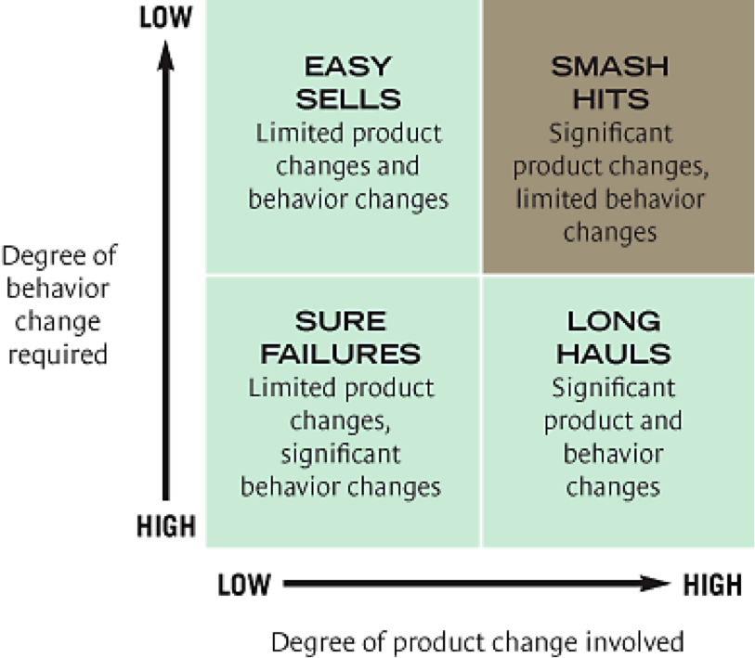
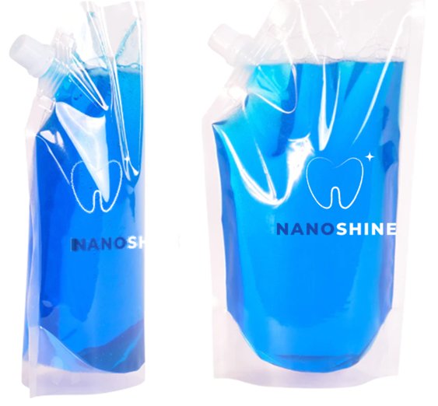
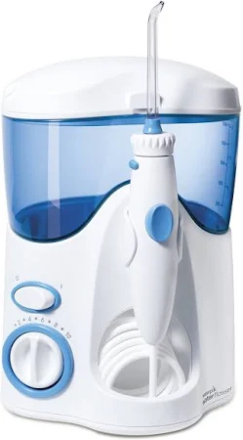
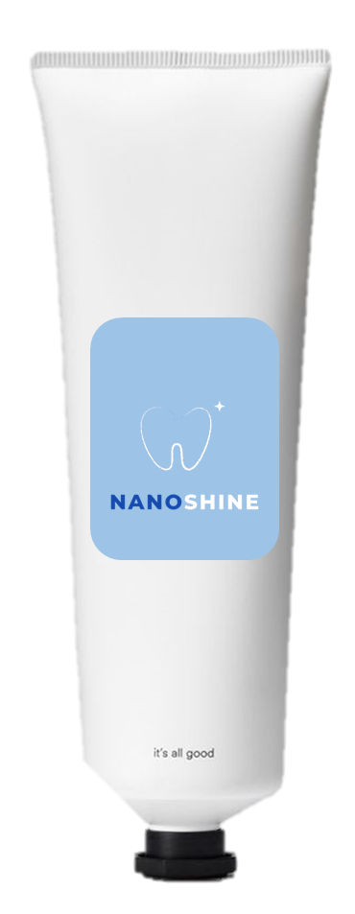
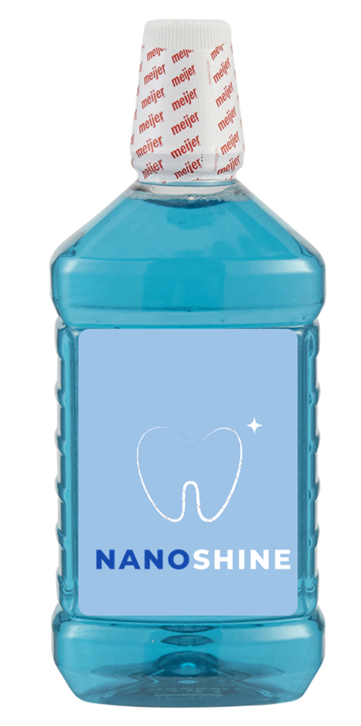
Segment Strategy & Product Positioning
The core product is a solution for water floss
Initial focus on water flosser users (see main customer segment)
Initial introduction into water floss market with potential expansion into additional application areas (CAGR of 5.3% from 2021 to 2028¹)
VALUE PROPOSITION
“get more out of your hygiene routine with no additional effort”
GAIN CREATORS
Minimal behavior change required among water flosser users
Scientifically proven to disrupt the structural integrity of dental biofilms
Extra touchpoint of biofilm removal after brushing and rinsing
PAIN RELIEVERS
Prevention of dental caries and periodontal disease
Better removal of visible and nonvisible plaque
Peace of mind that the best possible hygiene routine is being followed
JOBS TO BE DONE
Removal of dental biofilm beyond standard brushing, flossing, and mouth rinse
Minimize risk for dental caries and oral disease
Maintain oral hygiene between professional cleanings
PHASE 1: INTRODUCE WATER FLOSSER FLUID
Primarily competing against sink water (free)
Establish NanoShine™ brand and value of nanoparticles for oral hygiene
Consider partnership/bundle option with existing Water Flosser brands
PHASE 2: DEVELOP ADDITIONAL APPLICATION AREAS
Higher competition
Brand trust required before expanding applications
Notes:
Thanks Alex. Now after our hypothesis testing we come to the segment strategy part. We are

Slide 8
TAM / SAM / SOM
TAM ($35.417 Billion)
TAM: US population * $107 per NanoPik product
SAM: Total water flosser market (2022)
SOM 1: Water Pik’s total revenue (2022)
SOM 2: Revenue generated by US dentist/hygienist KOL referrals
SAM ($827.4 million)
SOM ($431.3 million)
SOM 1
WaterPik ($198.5 million)
SOM 2
Dentist & Hygienist
($232.8 million)

Slide 9
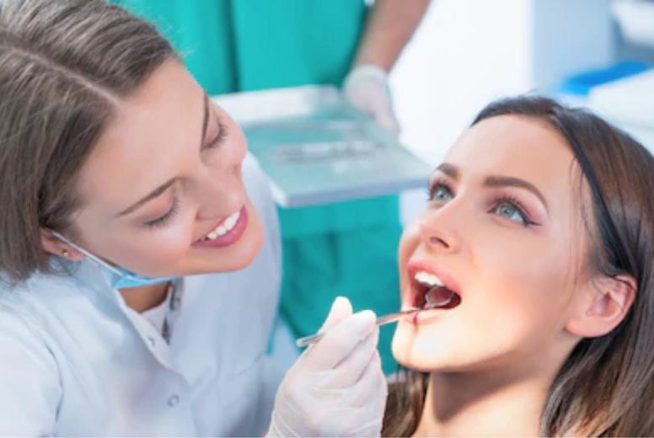
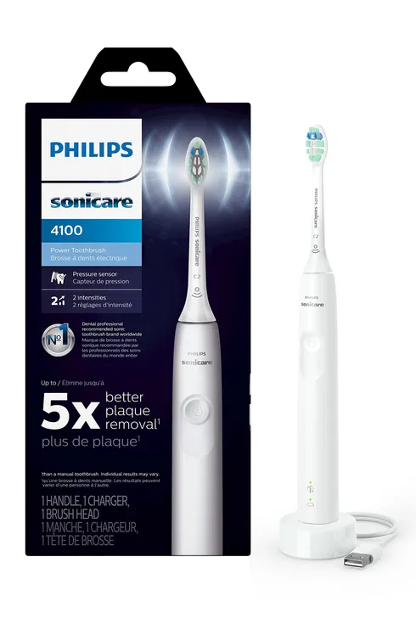

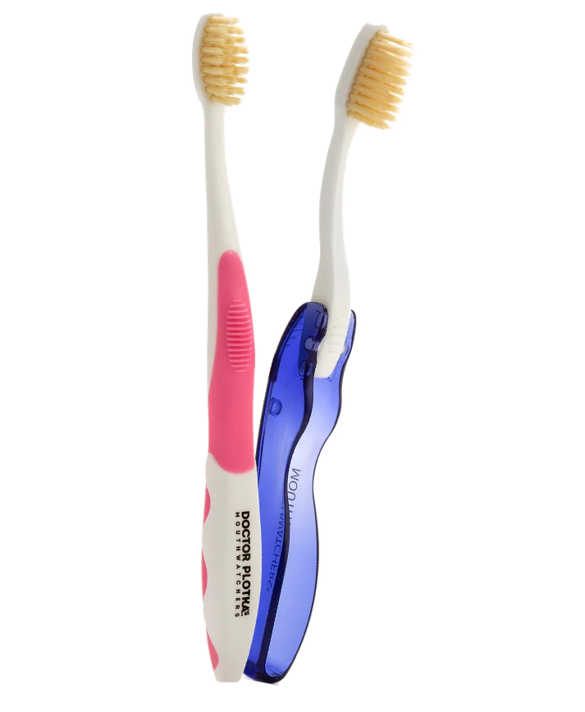

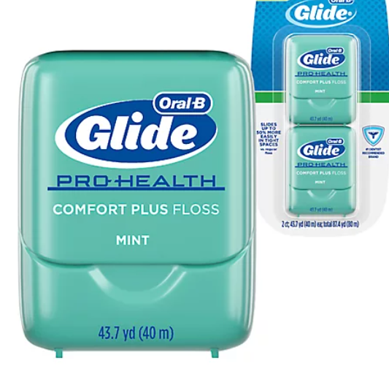
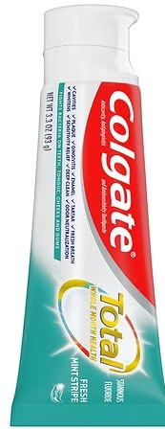
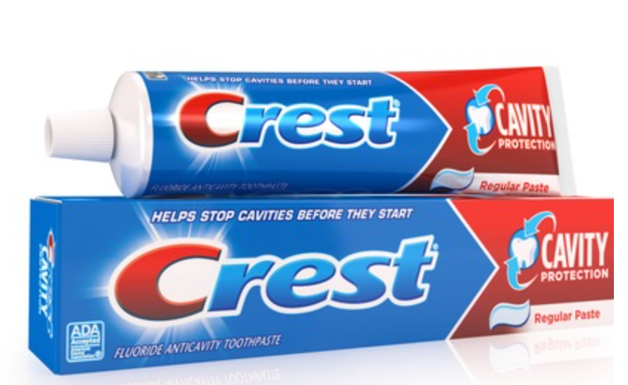
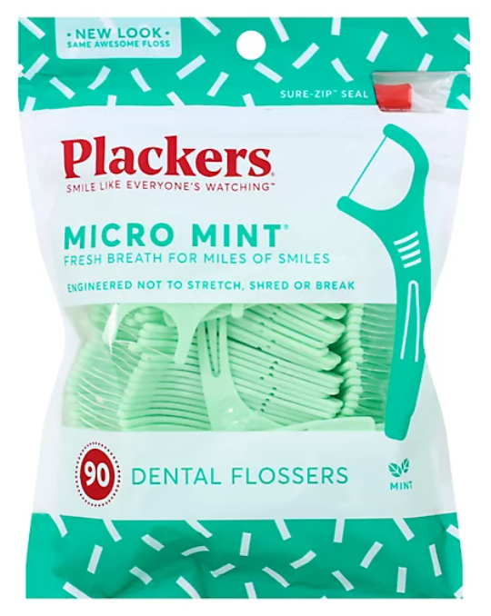
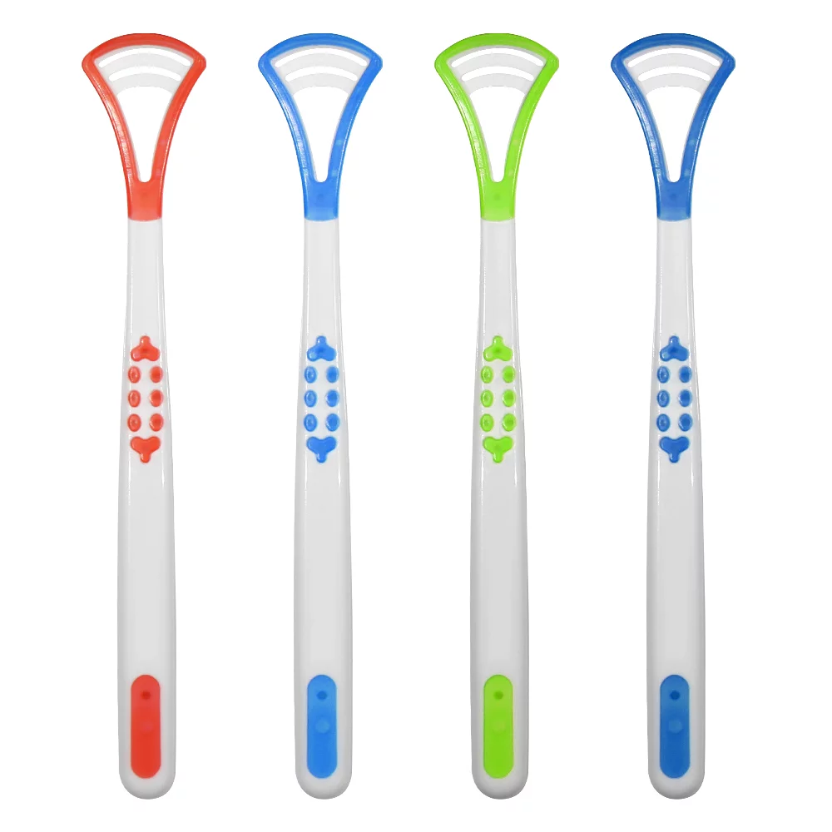
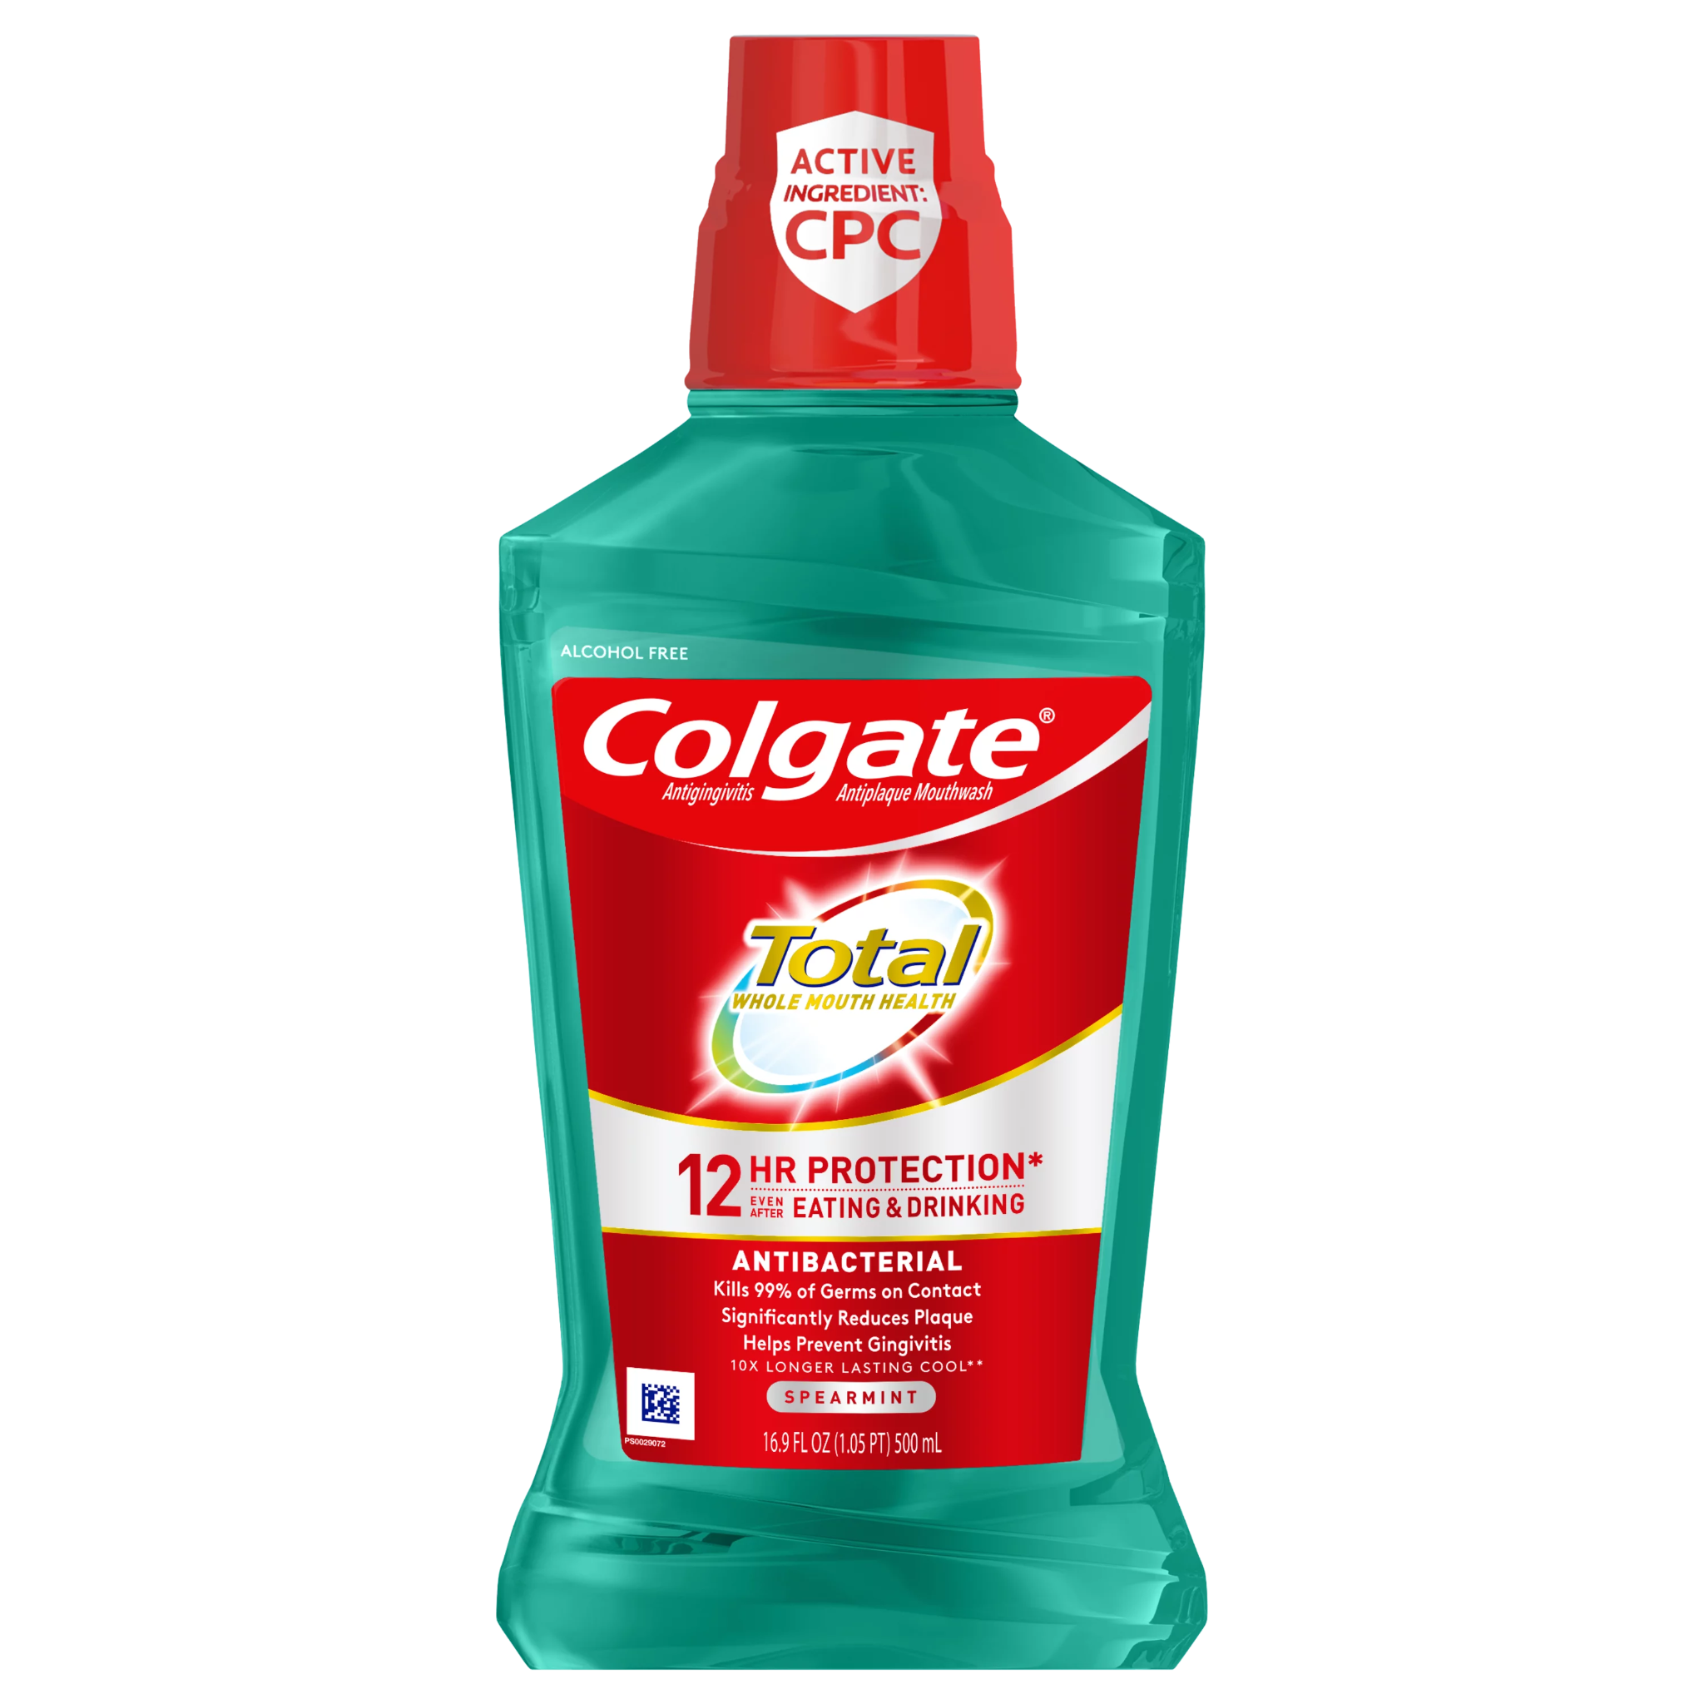
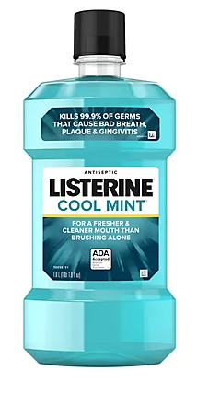
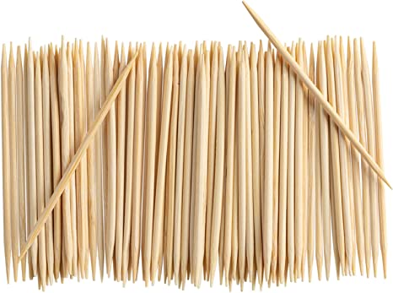
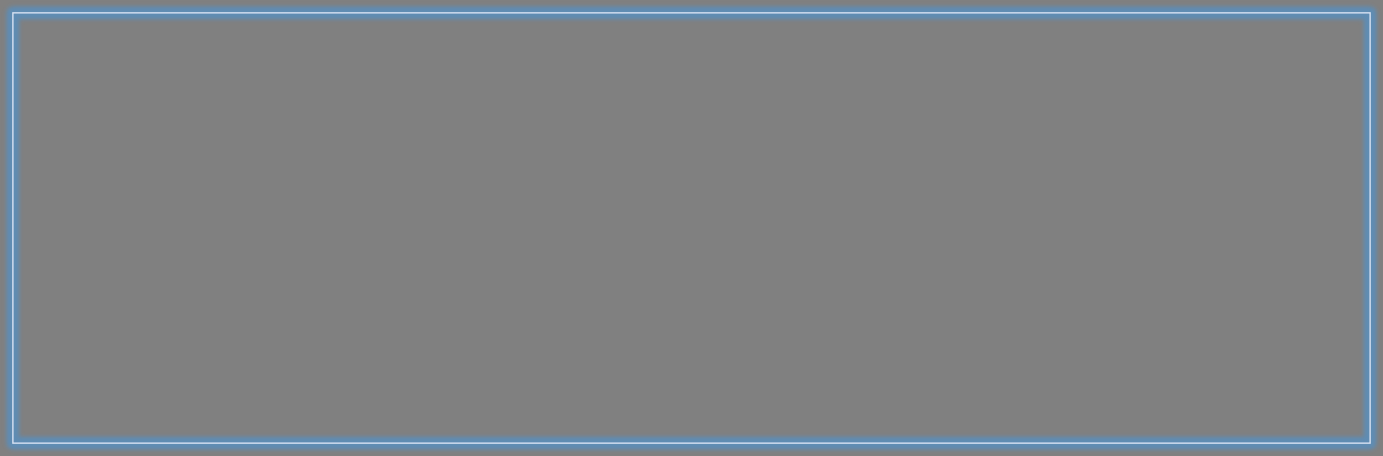
﻿﻿﻿Competitive Positioning
PROFESSIONAL CLEANING
High biofilm removal
(Water Only)
Manual (Labor Intensive)
Automatic (Non-Labor Intensive)
Biggest Competitor: The Status Quo
Water flosser users currently use tap or filtered water to floss their teeth
Our biggest competitive risk is customers choosing “free” water over our NaneShine™ fluid
NanoShine™ aimes to be a first-mover in the water flosser fluid market
Low biofilm removal
Definition of Competition: All existing plaque removal methods
Notes:
Gartner chart

Slide 10
Go to market Strategy
Strategy to acquire early adopters and early majority in 5 to 6 years
Strategic partnerships
Partner with Waterpik / Start building relation with KOL
Samples to Dentists
Free product demos
Exclusive online sale
04
Expansion Phase
Product diversification,
Sales Channel Diversification
NanoShine toothpaste & Dilute mouthwash
Distributors / CVS & groceries / E commerce
01
03
Establish Supply Chain
Distribution channels, warehouse, Demand-supply dynamics
Creating loyal customer base
Branding & success stories, Monitor performance metrics like:
Total Sales,
Unit economics
CAC
Understand Customer Success
02
Notes:
Thanks Alex,
We have seen where does our product stand in the market,
Now lets see how we plan to enter the market.
Go to market strategy has 4 fronts. We imagine 5 to 6 years time axis to realize this process.
At first, we recommend to form strategic partnerships in the dental ecosystem.
A close partnership with Waterpik - the most dominant water jet floss.
Since their customer base is almost exactly our customer base, we save a lot of money in marketing or acquiring the customers.
Also, we start partnering with dentist, or the KOL’s to try our products and or offer to their patients.
Second front is creating the loyal customer base and dominating the niche.
We recommend to go slow steady in next couple of years. This is just 7 dollar concentrate but the lifetime is very high.
If one person becomes a user, he is a lifetime customer. probably his family would also become user and
Let people use it, let them experience the results, and company can monitor customer success, unit economics.
We want to create the brand image the product to be something is more on the medicine side, than something that like chewing gum available over the counter.
After acquiring early adopters, and patiently converting them into loyal customers, we recommend to expansion phase.
Introducing 2 new products and going to super markets and increasing availability. Before this expansion, supply chain needs to be established well.
So this is how we can target early adopters and early majority.
Going from clinics & waterpiks to supermarkets is the chasm in this case.
Now I will pass on to Mandi to discuss the revenue model.

Slide 11
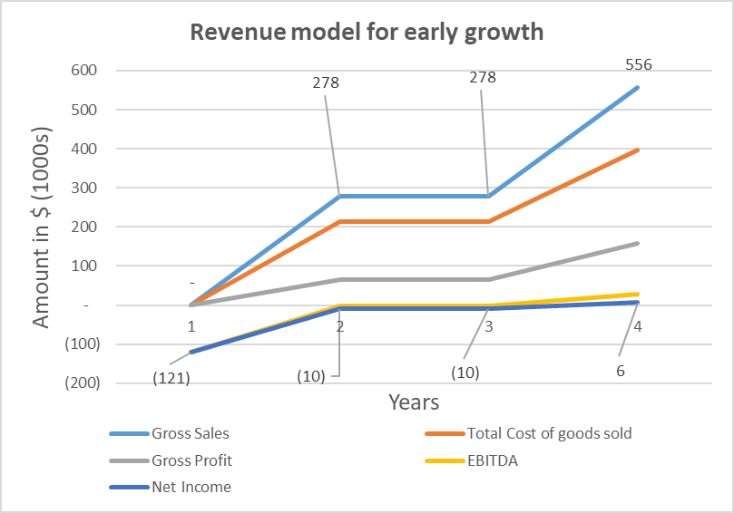
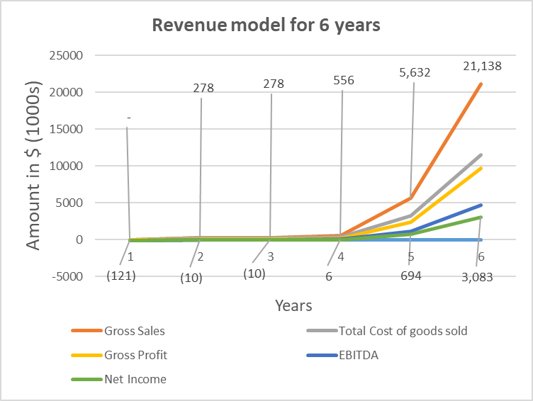
Revenue Model
All numbers in thousands. Unit Price = $7/L of concentrated NanoPik solution. Gross margin = 22%-45%

Slide 12
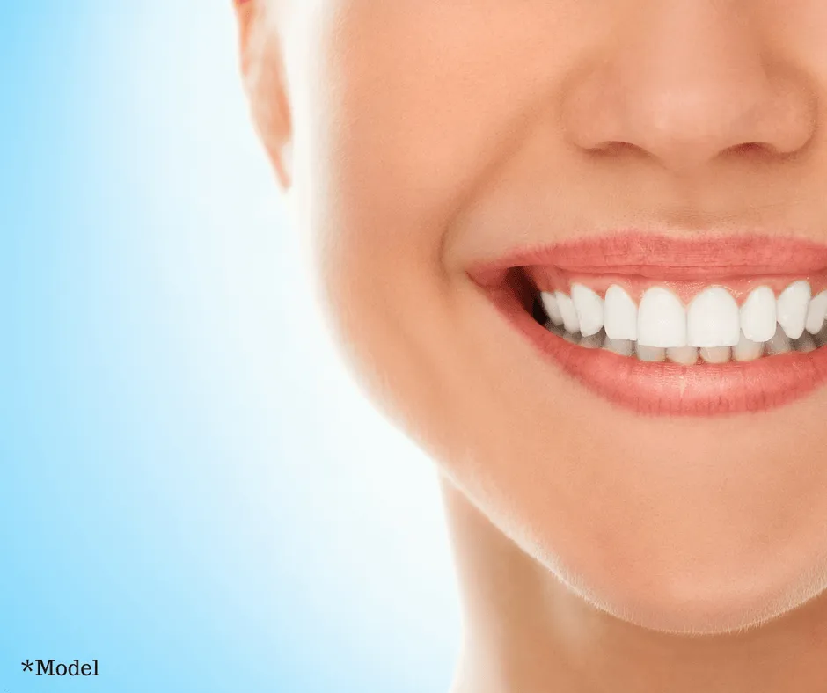
Thank You

Slide 13
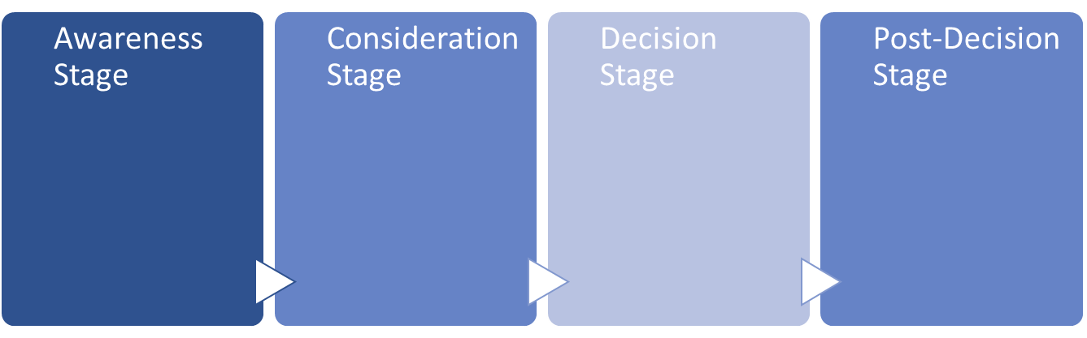
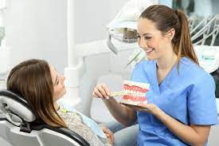
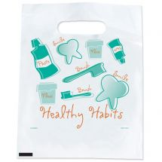
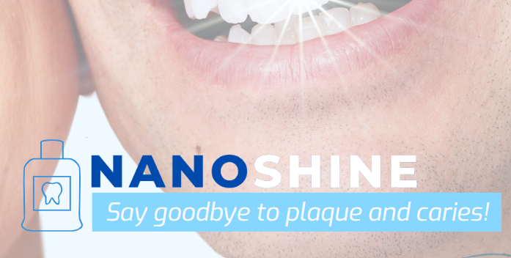
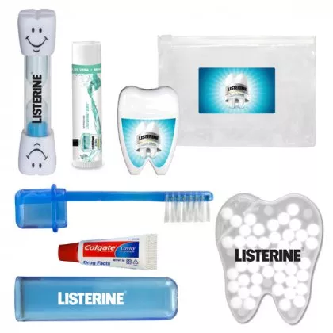

Appendix: Buying Process
-Patient is educated by dentist or dental hygienist on plaque/biofilms
-Options for removing biofilm are presented
-NanoShine™ samples/ coupons are provided
-Patient tries samples
-Patient conducts personal research
-Patient asks personal network about product & competitive solutions
-Patient orders NanoShine™ fluid online via NanoShine™ or WaterPik™ websites
-Patient evaluates effectiveness of product vs. price over time
-Patient evaluates whether he or she will rebuy / sign up for a subscription

Slide 14
Appendix: TAM/SAM/SOM
TAM/SAM/SOM Calculation:
TAM: US population 331 million * $107 = $35.417 billion
SAM: $827.4 million
SOM (WaterPik): $198.5 million
SOM (Dentist & Hygienist): $232.8 million (207,190*3500*0.01*30%*107=232,777,965)

Slide 15
Appendix: Revenue Model
Unit Price = $7/L of concentrated NanoPik solution
 | 1 | 2 | 3 | 4 | 5 | 6
Gross Sales | - | 277,900 | 277,900 | 555,800 | 5,631,955 | 21,138,320
WaterPik market | - | 277,900 | 277,900 | 555,800 | 555,800 | 833,700
Dentist/Hygienist market | - | - | - | - | 5,076,155 | 20,304,620
COGS | - | 214,380 | 214,380 | 397,000 | 3,218,260 | 11,475,088
Setup expenses | 17,500 | - | - | - | - | -
SG&A | 120,609 | 60,304 | 60,304 | 120,609 | 1,222,134 | 4,587,015
Commission | - | 62,527.5 | 62,527.5 | 125,055 | 1,267,189 | 4,756,122
NI | (120,608) | (9,655) | (9,655) | 5,780 | 694,177 | 3,082,566
Notes:
Factor in the manufacturing of the solution

Slide 16
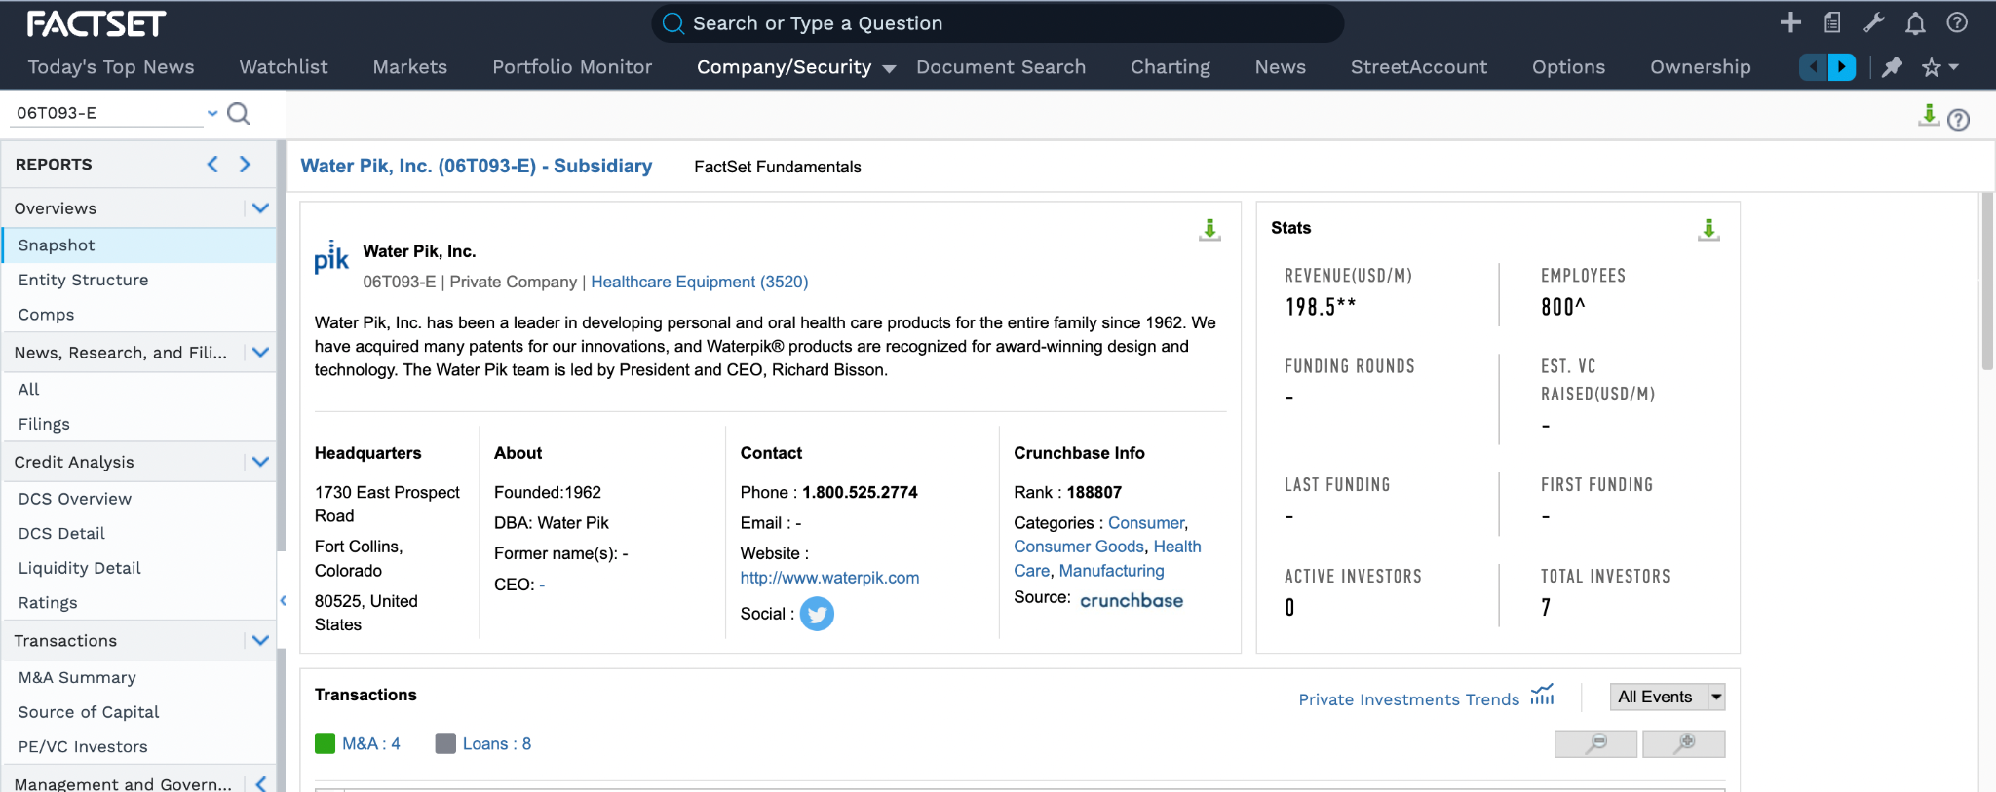
Appendix: Full Forecast
Full F/S forecast with assumptions and sources (https://docs.google.com/spreadsheets/d/1xX8vS9cFlBrPEr3qOvIuYvczcJGsegov/edit?usp=sharing&ouid=107696486163955369133&rtpof=true&sd=true)

Slide 17






Appendix: Funding Strategy
Small Business Innovation Research (SBIR) Grants
Angel Investor Networks
Venture Capital Funds
Family Offices and Individual Investors
Incubators and Accelerators
Corporate Venture Capital

Slide 18
Appendix: Funding Model
 | 1 | 2 | 3 | 4 | 5 | 6
Capital Required | $138,109 | $342,645 | $342,645 | $653,529 | $5,817,689 | $21,231,480
Revenue from sales | - | $277,900 | $277,900 | $555,800 | $5,631,955 | $21,138,320
Allocation of funds | 87% - SG&A | 62% - cost of goods 18% - SG&A and Commision each | 62% - cost of goods 18% - SG&A and Commision each | 60% - cost of goods 19% - SG&A and Commision each | 55% - cost of goods 22% - SG&A and Commision each | 54% - cost of goods 22% - Commision
Notes:
Factor in the manufacturing of the solution

Slide 19
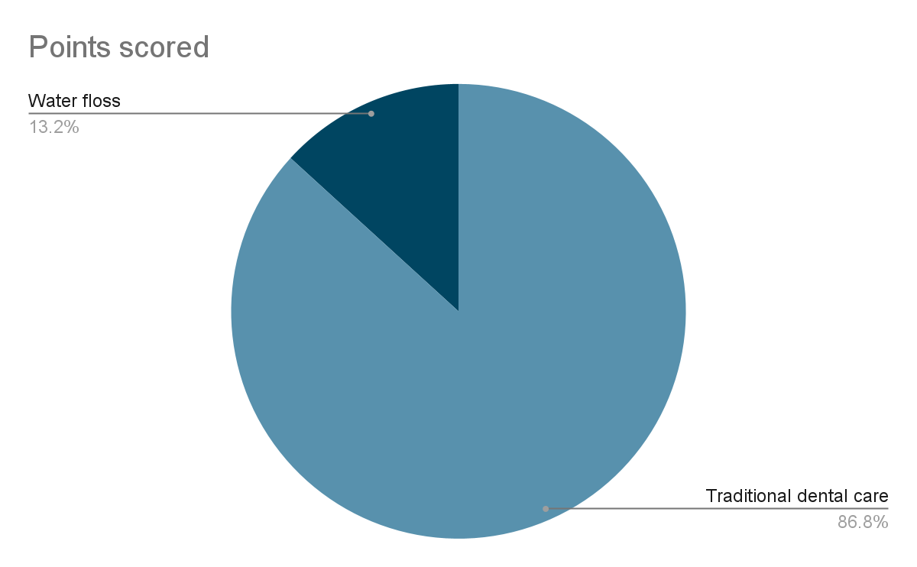
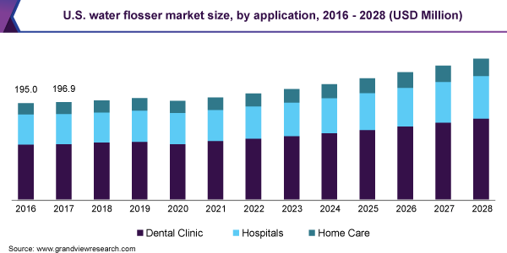
Appendix: Market Research
Water floss market trend and projection¹
Water floss market comparison with traditional hygiene product (toothbrush)¹
Customer Discovery interviews:
https://drive.google.com/drive/folders/1Q5xM1FvRa943qgRdZuNFeW_vdrYx8ZDr?usp=share_link

Slide 20
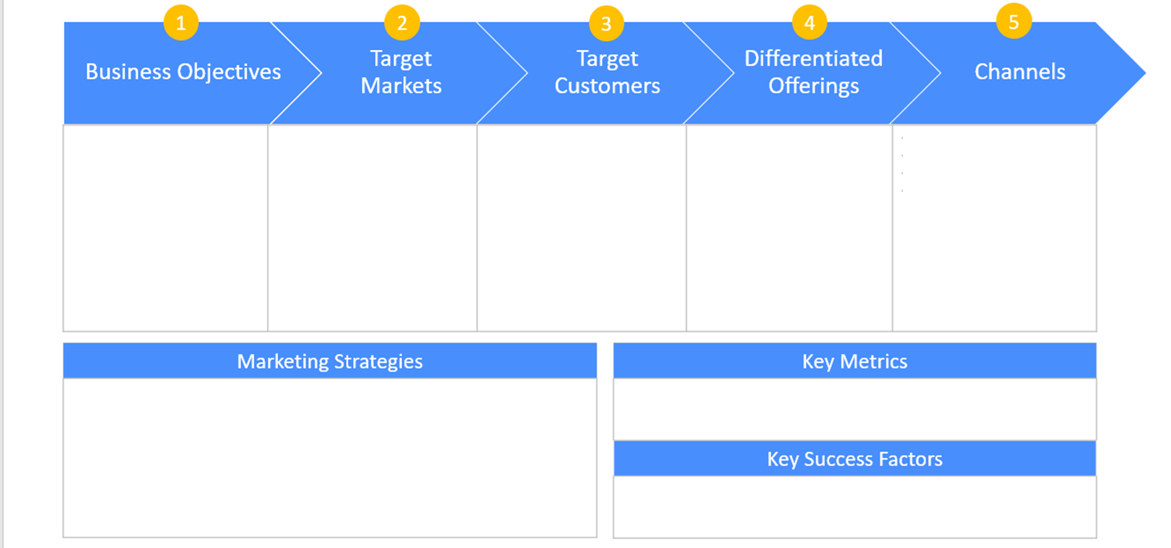
Appendix: Go-to-Market / Strategic Recommendation
-Acquire 10% of water flosser users and of dental patients
-Water Flosser market
-North America (USA) focus
RISK: must create a “water flosser fluid” market
PRIMARY:
-Water flosser users
-Dental patients who maintain above average oral hygiene
-Patients who may have chronic dental issues
SECONDARY:
-Oral hygienists
-Dentists
-Educators
-First-in-kind water flosser fluid product
-Bulk options available to minimize number of re-orders required
-Subscription options available
-Discounts and samples available through dentists, and with waterpik flossers [coupons at dentists office, with each bottle]
PHASE I:
-Available through NanoShine website, WaterPiK website, and select dental offices only
PHASE II:
-Available at all dental offices
-Available for retail purchase
-Partner with one water flosser provider (Waterpik) during launch phase; extend to other companies in growth stage
-Partner with dental systems; dentist and dental hygienist are critical educators who are necessary for broader adoption
-Number of product sales
-Number of discount redemptions
-Number of unique purchasers
-Customer acquisition cost
-Customer lifetime value
-Partnership with dental providers
-Operational stability
-Adoption by earlier adopters vs. current solution (Water Only Flosser)
Notes:
Pranav Kulkarni: Do we partner or not? Special dentists first. Where does it makes the most sense to enter which does not burn a lot of money (A little easier and little bit less expensive).

Slide 21
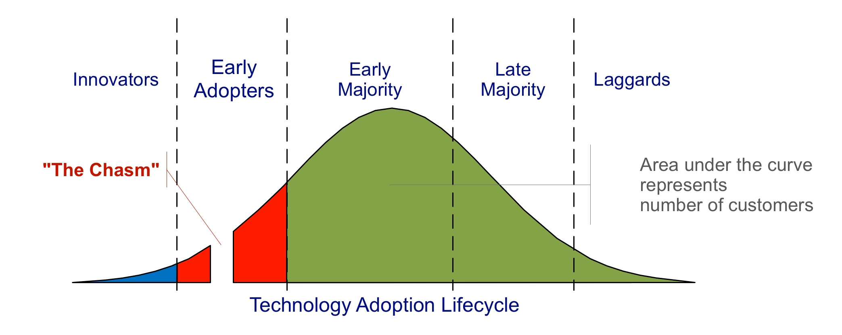
Appendix: Go-to-Market / Strategic Recommendation
Early Adopters customer profile = people having expensive and time consuming habits or routine like water floss
Chasm = need of distribution channel, low prices, over the counter availability
Make early adopters your advocates. A word of mouth is strongest marketing tool in this area.
Align your supply before expansion. Establish new products before competition hits.
This product has higher lifetime value to customers.

Slide 22
Appendix: Go-to-Market Strategy (Continued)
Strategy
Action items
Target Customer
Step 1) Strategic Partnerships
Partner with Waterpik / Start building relation with KOL
Step 2) Loyal customer base
Branding efforts & success stories
Step 3) Establish Supply Chain
Distribution channels, warehouse, Demand-supply dynamics
Step 4) Expansion Phase
Product diversification,
Sales Channel Diversification
Provide samples through dentist
Give free products
Online sales through website.
Establish & Monitor KPI’s
  Total sales
  Demography of customer
  Cost of acquisition
  ifetime value
Brand before expansion
Product line extension
Distributors / CVS & groceries / E commerce
Early adopters
Early Customers
Brand before expansion
Product Line Expansion

Slide 23
Appendix: References
Water flosser market size: Industry report, 2021-2028. Water Flosser Market Size | Industry Report, 2021-2028. (n.d.). Retrieved April 21, 2023, from https://www.grandviewresearch.com/industry-analysis/water-flosser-market
Dickinson, G. (October 6th, 2022). How to navigate and negotiate contracts with third-party food delivery platforms. Back of House. Retrieved from https://backofhouse.io/stories/tips-navigate-negotiate-restaurant-contracts-third-party-food-delivery-platforms-commission-rates.
Bureau of Labor Statistics (May, 2021). Occupational Employment and Wage Statistics. Retrieved from https://www.bls.gov/oes/current/oes291292.htm.
Bari, S. (February, 2022). IBIS World. Mouthwash manufacturing in the US. Retrieved from https://my-ibisworld-com.libproxy2.usc.edu/us/en/industry-specialized/od6033/key-statistics.
Go Cardless (January, 2021). Market penetration strategy. Retrieved from https://gocardless.com/en-us/guides/posts/market-penetration/#:~:text=market%20penetration%205%25.-,What%20is%20a%20good%20rate%20of%20market%20penetration%3F,already%20doing%20better%20than%20most.
Factset (2022). Factset Fundamentals - Water Pik. Retrieved from https://login.factset.com/login/xoM4jTODNt1DQZiEFfv2epjgwEy_90OY4PMHmCT4nVWBNoOUq5l1gngk-6goz21COdbrZuVD15k0pCIYD-6Iucp8o8wZ2KRMX8YMq9xq_3_4HnMLvSWXbN42I39yGY3LvVjPTnQGizAhdBPHyQeVlc9v1-pdkV1N2Ma4vhKzebJkjAFfUBBV5T7v5A6IwBY8Lq9NFqP1B4-1joSSJilQDA/xoM55/9xq81.

